Slide 1
Visualization of Tojisha Kenkyu studies: A text mining approach to recovery (and discovery) Tomoe Kodaira (Seirei Christopher University) Takehiko Ito (Wako University) 19th East Asian Forum of Nursing Scholars (EAFONS 2016) Poster Session 0103 Session Category: Psychiatric and mental health nursing March 14, 15:00-15:30, 2016 Makuhari, Chiba, Japan

Slide 2
Problem: What is Tojisha Kenkyu (Self-directed research)?
Tojisha Kenkyu was born from daily activity of Bethel （social welfare cooperation located in Urakawa Town, Japan) members who suffer with schizophrenia and other mental disorders.
Research topics or themes are mainly from daily issues that the clients (and their family members, and sometimes supporters (social workers, nurses, etc.)face in every day life. Research starts with a question of “What is troubling me?”
Tojisha Kenkyu treats hallucinations and delusions as most important materials for research findings and solutions for healthier and easier life. Also a person’s success stories are as important as hallucinations and delusions.
Sato, S. et al. (2014). How can Tojishya Kenkyu (self-directed research) deepen student’s
self-understanding? :Effectiveness of Tojisha Kenkyu for better understanding of self. SWSD.

Slide 3
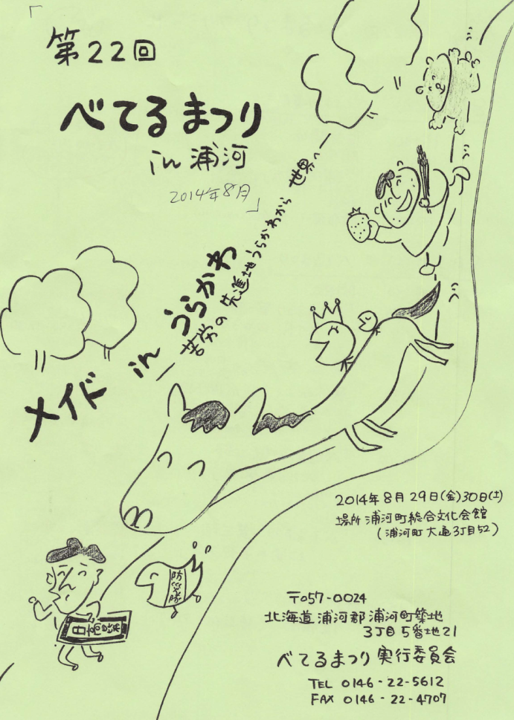
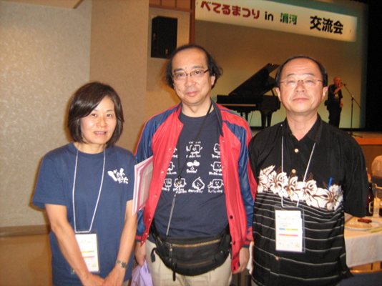
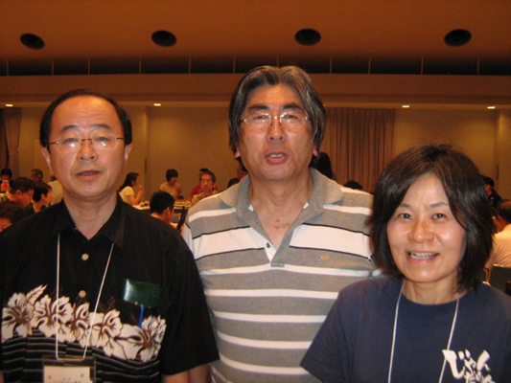
Bethel Festival & National Conference of Tojisha Kenkyu Aug 2014
With Mr. Mukaiyachi （PSW)
With Dr. Kawamura （MD)

Slide 4
Steps necessary to conduct Tojisha Kenkyu (self-directed research)
1) Differentiate between the "problem" and the "person": Change how you think about yourself from “I ‘ m Hiroshi who keeps blowing up" to "I'm Hiroshi who is struggling with the issue of how to stop blowing up even when I don't want to.
2) Create a self-diagnosis: Don't just use the medical diagnosis but create your own self-diagnosis that encapsulates the meanings and circumstances of what you are struggling with. For example, "Schizophrenia: Runs-out-of-money-by-the-end-of-the-week type." This helps your peers understand what you are struggling with and helps them talk about it. It's an important part of you feeling ownership over your problems.
3) Figure out the patterns and processes of your problems: There must be some rules that regulate how your symptoms occur, actions that lead to them occurring, or things that lead to problems such as "running out of money."
4) Try to think of concrete ways that you can help yourself or protect yourself and scenarios where you can practice them.
5) Verify your results. (Nakamura 2013: p174; Mukaiyachi 2005: 4-5)

Slide 5
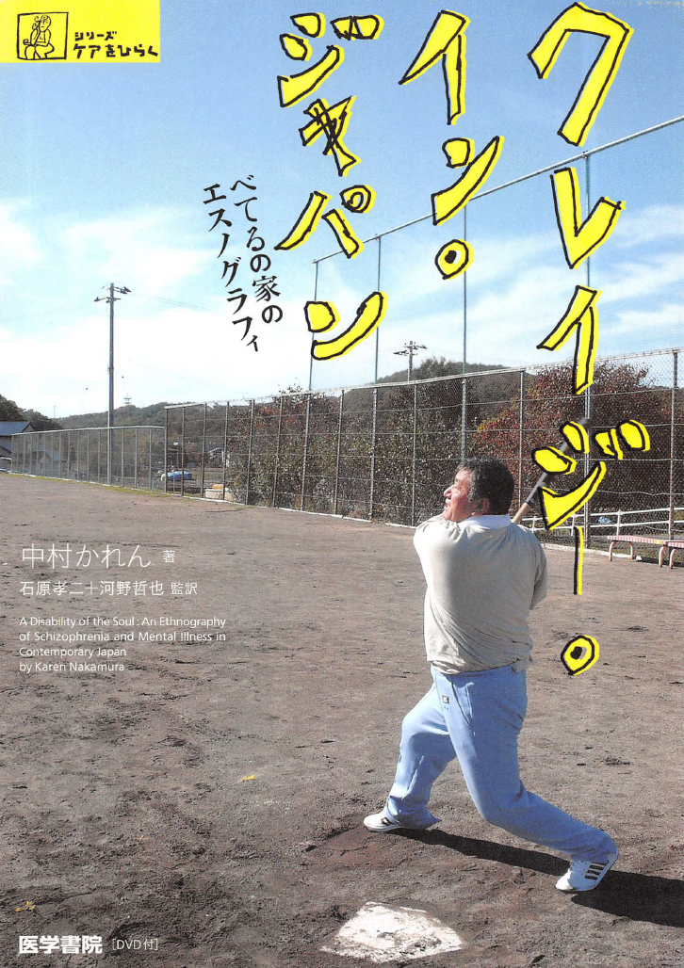
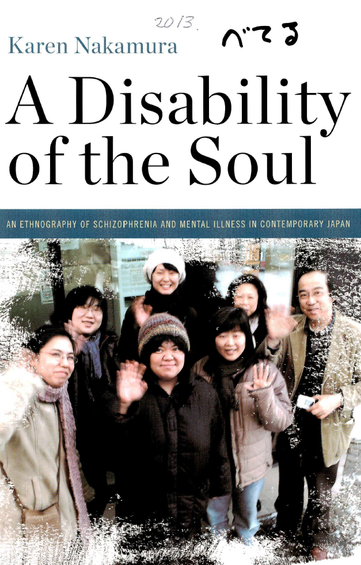
A book of ethnography of Urakawa Bethel people 中村（20） Nakamura（2013）

Slide 6
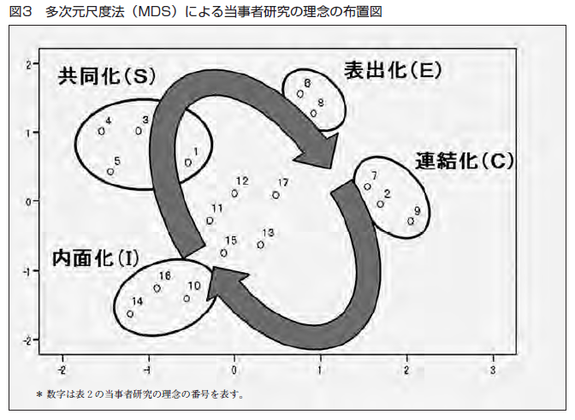
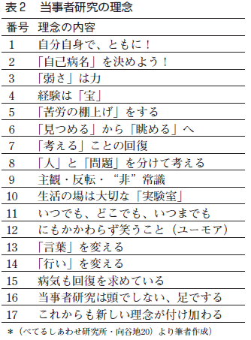
Tojisha Kenkyu & SECI model (Ito, 2011)
Socialization
Externalization
Combination
Internalization

Slide 7
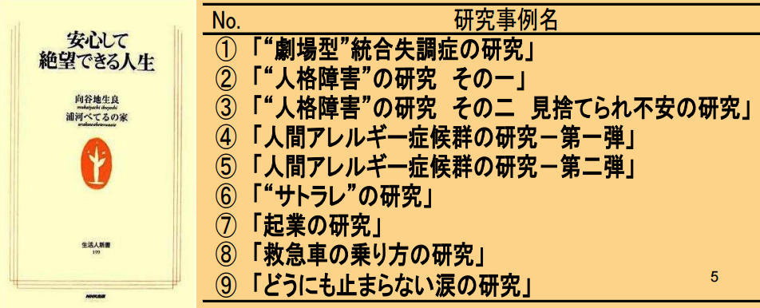
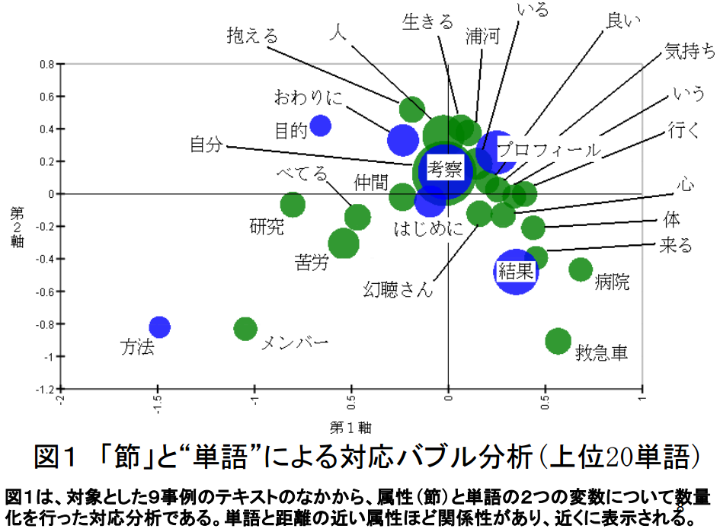
Ohtaka, Ito, Kodaira, (2010) revealed the structure of Tojisha Kenkyu study reports of people with mental illness at Urakawa Bethel House by analyzing a book, entitled ‘Life you feel helpless with peace of mind.’ The report structure was identical to the patterns of scientific papers.
Conclusion
Purpose
Profile
Discussion
Results
Method

Slide 8
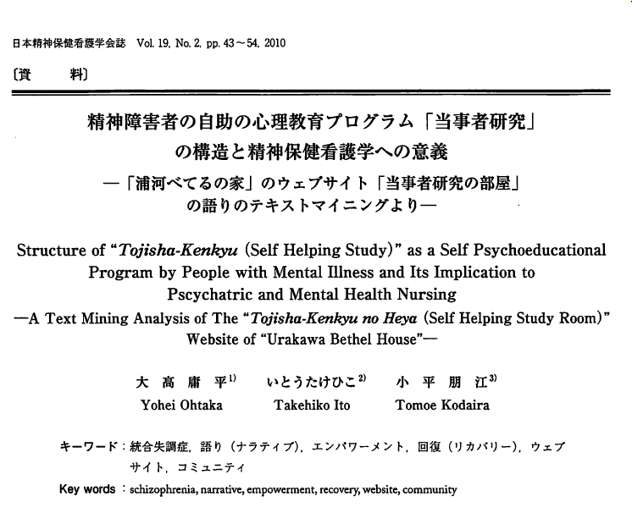
Ohtaka, Ito and Kodaira (2010) analyzed the website, “The Room of Tojisha Kenkyu Studies,” which is also based on the activities at Urakawa Bethel House, and recognized the structure of recovery process by reclaiming stories of their suffering with peers.
Hardship & Peers
Disease
Self & others
Urakawa

Slide 9
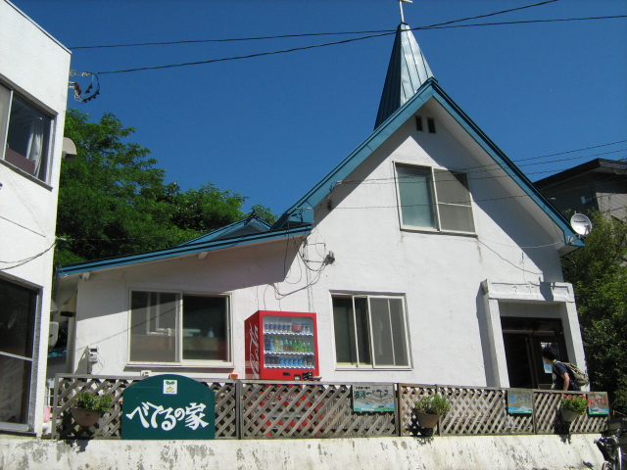
Purpose
The aim of the present study is to reveal the process of recovery and discovery in the Tojisha Kenkyu studies more deeply by a text mining analysis of expressions written in the books edited by Urakawa Bethel House.
べてるしあわせ研究所・向谷地生良 『レッツ！当事者研究』 NPO法人コンボ
・第１巻（2009年） ・第２巻（2011年）

Slide 10
Method
The text was two volumes of “Let’s Tojisha Kenkyu,” which consisted of six areas of content of suffering: communication, hallucination/ delusion, social and self relationship, romantic love, work, and dependence.
There were 36 case chapters consisting of 15 men, 16 women, and 5 couples. The text was analyzed by Text Mining Studio 4.2.
べてるしあわせ研究所・向谷地生良 『レッツ！当事者研究』 NPO法人コンボ
・第１巻（2009年） ・第２巻（2011年）

Slide 11
Results: (1) Basic Statistics
There were 4128 sentences by 24249 total words with 4981 type words. The most frequently used words were self, suffering, person, study, peer, work, Urakawa, guest (i.e. intrusive negative thinking), understand, and Mr.Voices (i.e. personalization/externalization of auditory hallucination).

Slide 12
Results: (2) Word Frequency Analysis
Self「自分」（657）
Struggle/ hardship「苦労」（244）
People「人」（244）
Research「研究」(177)
Peer「仲間」(161)
Work「仕事」(124)
Urakawa「浦河」(119)
Unwanted visitor 「お客さん」(105)
Understand「わかる」(104)
Gencho-san (Mr. Hallucination)
「幻聴さん」(100)

Slide 13
Results: (3) Positive-Negative Analysis
●Positive Nouns (好評語)
Self「自分」(29), People「人」(19), Hardship「苦労」(13), Mr. Hallucination 「幻聴さん」 (10), Companionship「つきあい」 (7), Ways to help「助け方」 (7), Feeling「気持ち」 (6), Peers「仲間」 (5), Unwanted visitor「お客さん」 (5), Human「人間」 (5).
●Negative Nouns (不評語)
Self「自分」 (29), Information disclosure「情報公開」 (15), Others「人」 (9), Human relationship「人間関係」 (7), State「状態」 (7), Condition「具合」 (6), Work「仕事」 (6), Feeling 「気持ち」 (6), Mr. Hallucination 「幻聴さん」 (6).

Slide 14
Discussion
Tojisha Kenkyu mostly studies about self, disease suffering, and human relationship according to word frequency analysis.
Positive aspects of process of the self-direct research activities are shown by positive-negative analysis.
In Tojisha Kenkyu activities, the process of discovery leads to the result of recovery in everyday life.
As it facilitates recovery after the difficulty in life, Tojisha Kenkyu promoted posttraumatic growth of people with mental illness.

